Slide 1




1845 to 1851
Chapter 17
THE GREAT IRISH FAMINE
the great irish famine
Strand Two: The History of Ireland
@MsDoorley

Slide 2

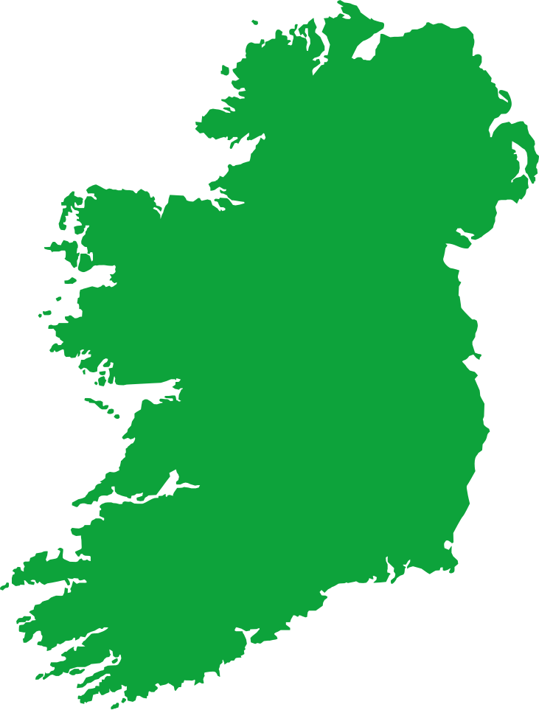
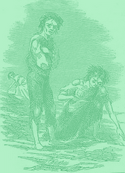


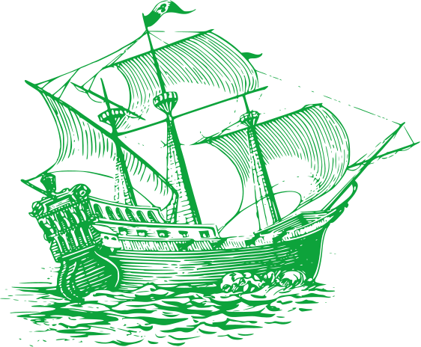
Chapter 17
THE GREAT IRISH FAMINE
AN GORTA MÓR
The second crop dies
Sir Robert Peel resigns as Prime Minister
Year of Revolutions
Evictions start to take place
Young Islander Rising
The Famine comes to an end.
1845
1846
1847
1848
1849
1850
1851
Strand Two: The Nature of History
Chapter One: The Historian
The Great Famine begins in Ireland as the first blight causes the potato crop fails
Black ‘47 – Worst Year of the Famine: Soup Kitchens and Workhouses are set up as relief: Mass Chain Emigration rapidly increases
Potato Crop fails again. Famine is accompanied by cholera outbreaks.
The island is largely blight-free.
Population has decreased massively.
@MsDoorley

Slide 3
Learning Outcomes
2.7 INVESTIGATE the causes, course and consequence, nationally and internationally, of the Great Famine, and EXAMINE the significance of the Irish Diaspora
1.1 DEVELOP a sense of historical empathy by viewing people, issues and events encountered in their study of the past in their historical context
1.2 CONSIDER contentious or controversial issues in history from more than one perspective and DISCUSS the historical roots of a contentious or controversial issue or theme in the contemporary world
1.4 DEMONSTRATE awareness of historical concepts, such as source and evidence; fact and opinion; viewpoint and objectivity; cause and consequence; change and continuity; time and space
1.7 DEVELOP historical judgements based on evidence about personalities, issues and events in the past, showing awareness of historical significance
Strand One: The Nature of History
Chapter One: The Historian

Slide 4
Introduction
The Great Famine of 1845-1850, also known as the Great Hunger, is one of the most important events of Irish history. Over these few years, the repeated failure of the potato crip in Ireland led to the deaths of between one and one and a half million people, while millions more emigrated to countries such as Britain, Canada, Australia and the USA. This catastrophe had many far-reaching consequences and changed the course of Irish history.
Strand Two: The History of Ireland
Chapter Seventeen: The Great Famine
@MsDoorley

Slide 5
1845 to 1851
Chapter 17
17.1: THE CAUSES OF THE GREAT FAMINE
17.1: the causes of the great famine
Strand Two: The History of Ireland
@MsDoorley

Slide 6
What caused the Great Famine?
The Great Famine happened across Ireland between 1845 and 1850. The potato crop had failed and without other crips to feed themselves, people died of starvation and disease, or were forced to emigrate (move to other countries). Several factors led to this catastrophe:
  Most Irish people were dependent on farming.
  With the steep rise in population and the subdivision of land, people had to survive on smaller plots of land which were often too small to sustain more than one crop.
  Tenant farmers and cottiers were very reliant on the potato as a source for food. Just 1 acre of land could grow enough potatoes to feed a family for six months. The potato was suited to Ireland's damp climate, making it easier to grow and harvest, and it stored well, unlike grain.
  Most cottiers worked land in exchange for their rent and didn't receive money payments so they had no cash to buy any other food if their potato crop failed.
  This dependence on farming and the potato made the poor vulnerable, so when potato blight struck, they were immediately out of options. Potato blight is a fungus that spreads in damp and humid weather and destroys potato crips.
Strand Two: The History of Ireland
Chapter Seventeen: The Great Famine
@MsDoorley

Slide 7
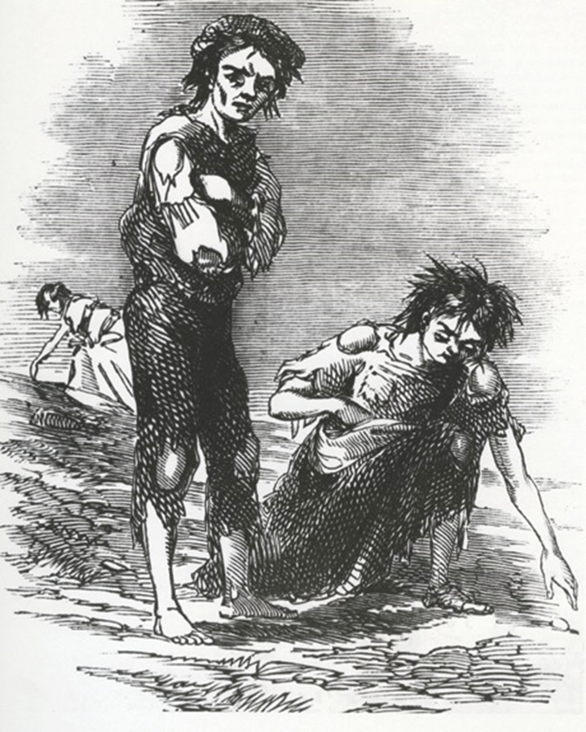
Causes of the Great Famine
Rise in population
Widespread poverty
Small farms
Reliance on the potato
Cottiers worked in exchange for rent rather than money
The potato blight
Strand Two: The History of Ireland
Chapter Seventeen: The Great Famine
Diagram taken from Artefact, 2nd Edition by Eimear Jenkinson and Gregg O'Neill (educate.ie)
@MsDoorley

Slide 8
Checkpoint pg. 174 (Artefact, 2nd Edition)
  When did the Great Famine occur?
  Why was the steep rise in population so damaging for Ireland?
  Why was the potato crop the main crop in Ireland?
  What is potato blight?
  Which of the causes of the Great Famine do you think was the most important? Give reasons for your answer.
Strand Two: The Nature of History
Chapter Seventeen: The Great Famine
@MsDoorley

Slide 9
Checkpoint pg. 174 (Artefact, 2nd Edition)
  Between 1845 and 1850.
  More people had to survive on smaller plots of land and became reliant on potatoes as the largest part of their diets.
  Just one acre of land could grow enough potatoes to feed a family for six months. The potato was suited to Ireland’s damp climate, it was easy to grow and harvest, and it stored well, unlike grain.
  Potato blight: a fungus that spreads in damp and humid weather and destroys potato crops.
  Any one, with a reason given: rise in population, poverty; subdivision of land leading to ever smaller farms; reliance on the potato; cottiers worked in exchange for rent rather than for money; the potato blight.
Strand Two: The Nature of History
Chapter Seventeen: The Great Famine
@MsDoorley

Slide 10
1845 to 1851
Chapter 17
17.2: THE FAMINE YEARS, 1845-1850
17.2: The famine years, 1845-1850
Strand Two: The History of Ireland
@MsDoorley

Slide 11
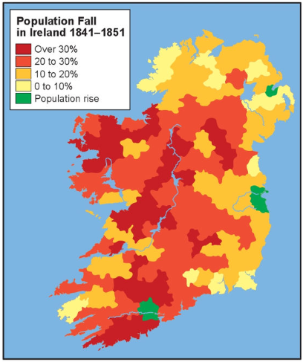
The course of the famine
The potato blight did not affect Ireland alone. Other European countries also lost their potato crops, but they were not as reliant on farming and had other available foods. In Ireland, the farming poor would suffer the effects of famine for years.
1845: farmers notice the potato stalks turning black. Earlier harvest saves the country from mass starvation
1846: Two-thirds of the crop lost to blight. The poorest began to starve. Diseases such as tuberculosis, measles and scarlet fever kill many.
1847: No potato blight but crop too small – deadliest year of the famine. ‘Black ‘47’. It is estimate that 300,000-500,000 died and over 250,000 emigrated.
1848-1850: starvation and disease worsened. 400,000 more people die in 1850 than in 1846.
Typhus and cholera killed many due to poor living conditions and dirty water. People moving into towns brought the diseases with them and it spread rapidly.
Strand Two: The History of Ireland
Chapter Seventeen: The Great Famine
Diagram taken from Artefact, 2nd Edition by Eimear Jenkinson and Gregg O'Neill (educate.ie)
@MsDoorley

Slide 12
The course of the famine
As the Great Famine took hold, many tenant farmers and cottiers could not pay their rent and were face with eviction (when someone is forced out of their home). Cottages were sometimes burned, or the roofs pulled in, to prevent the tenants returning. Some sympathetic landlords reduced rents or let those who could not pay stay on. A few even paid passage for their tenants to emigrate. Those who could afford to leave Ireland altogether were often considered lucky, though in reality they faced a hard and uncertain journey. The ships they boarded were unsuitable and became known as coffin ships because so many died on board of illness or starvation.
During these years, Ireland was producing (and exporting) large quantities of other food types, particularly grains. However, these were not even remotely affordable for the country's impoverished majority. Meanwhile, the middle and upper classes were almost untouched by hunger, homelessness and disease.
Strand Two: The History of Ireland
Chapter Seventeen: The Great Famine
@MsDoorley

Slide 13
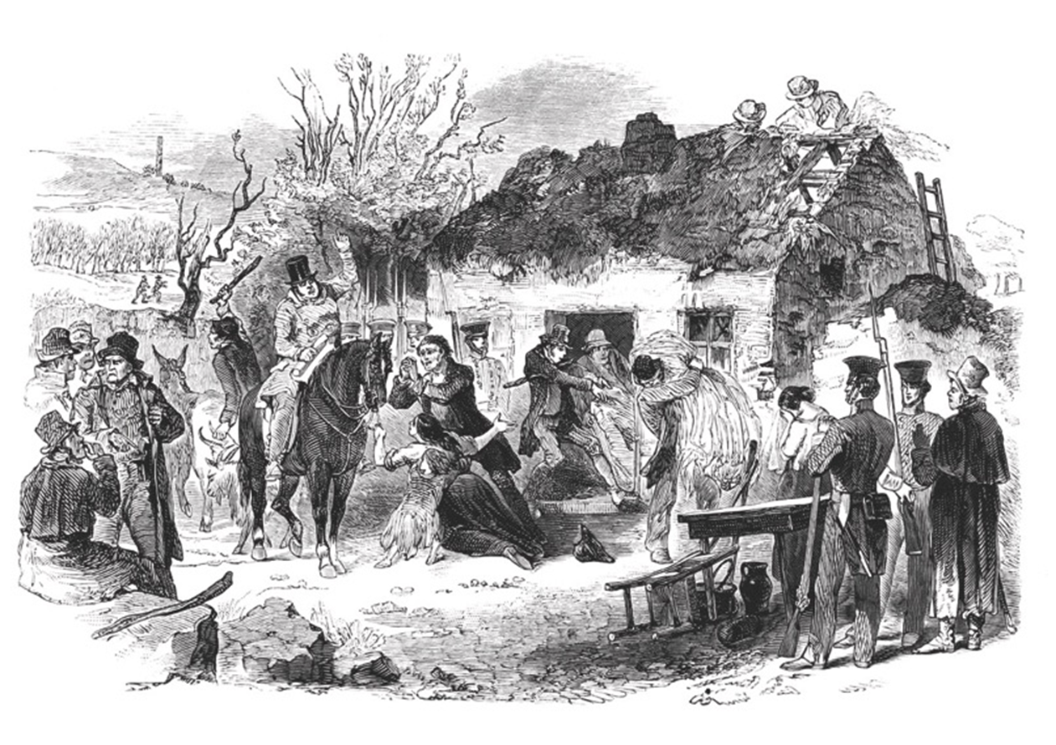
Strand Two: The History of Ireland
Chapter Seventeen: The Great Famine
Diagram taken from Artefact, 2nd Edition by Eimear Jenkinson and Gregg O'Neill (educate.ie)
@MsDoorley

Slide 14
Checkpoint pg. 176 (Artefact, 2nd Edition)
  Why was Ireland affected by the blight more seriously than other countries?
  What diseases affected people during the Famine? Why did they spread so easily?
  Explain the term eviction.
  Where did people evicted from their homes go to?
  Looking at the map, which areas were the worst affected? Why do you think this was?
  Why do you think the population rose in Cork city and Dublin city?
Strand Two: The Nature of History
Chapter Seventeen: The Great Famine
@MsDoorley

Slide 15
The Fields of Athenry
Written in 1979 by Pete St. John who based it on a story about a young man from the Athenry area who had been caught stealing corn to feed his family during the Famine and was deported to Australia.
The lyrics tell us that the convict’s crime was that he “stole Trevelyan’s corn”. This is in reference to Charles Edward Trevelyan, a big landlord and a senior British civil servant in Dublin Castle. Trevelyan famously said, “the judgement of God sent the calamity to teach the Irish a lesson". He believed that the starving Irish could subsist on maize, a grain that they could not afford. He is known for being one of the harshest landlords of the era.
Strand Two: The History of Ireland
Chapter Seventeen: The Great Famine
By a lonely prison wall
I heard a young girl calling
Michael, they have taken you away
For you stole Trevelyn's corn
So the young might see the morn
As a prison ship lies waiting in the bay
Low lie the fields of Athenry
Where once we watched the small free birds fly
Our love was on the wing we had dreams and songs to sing
It's so lonely 'round the fields of Athenry
By a lonely prison wall
I heard a young man calling
Nothing matters, Mary when you're free
Against the famine and the Crown
I rebelled, they cut me down
Now you must raise our child with dignity
Low lie the fields of Athenry
Where once we watched the small free birds fly
Our love was on the wing we had dreams and songs to sing
It's so lonely 'round the fields of Athenry
By a lonely harbor wall
She watched the last star falling
As that prison ship sailed out against the sky
Sure she'll wait and hope and pray
For her love in Botany Bay
It's so lonely 'round the fields of Athenry
Low lie the fields of Athenry
Where once we watched the small free birds fly
Our love was on the wing we had dreams and songs to sing
It's so lonely 'round the fields of Athenry
The Fields of Athenry – The High Kings cover
@MsDoorley

Slide 16
Working with Sources
  Why was Michael taken away, according to the song?
  What is the significance of the "prison ship" in the song?
  How does the song describe the condition of the "fields of Athenry" during the Famine?
  What stance did Michael take against the Famine and the Crown, and what were the consequences?
  Who is Trevelyan, and what is the significance of "Trevelyan's corn" in the context of the Great Famine?
  What does Michael's rebellion against the "Famine and the Crown" reveal about anti-British sentiments in Ireland during the Famine?
Strand Two: The Nature of History
Chapter Fourteen: The 1798 Rebellion
@MsDoorley

Slide 17
Working with Sources (Answers)
  Michael was taken away because he stole corn from Trevelyan. He did this in an attempt to help the young in his family survive, as indicated by the line "For you stole Trevelyan's corn so the young might see the morn."
  The "prison ship" signifies the penal transportation system, where individuals convicted of crimes in Ireland and Britain were deported to penal colonies like Australia. Michael is to be sent away on such a ship, which reflects the historical practice of deportation during and after the Great Famine.
  The song describes the fields of Athenry as "low," possibly indicating poor yield or desolation. It contrasts this with a time "where once we watched the small free birds fly," suggesting that the land was once fruitful and free but is now lonely and barren.
  Michael rebelled "against the famine and the Crown," indicating opposition to both the desperate conditions of the Famine and British governance. As a result, "they cut [him] down," which means he was arrested and sentenced to deportation.
  Charles Edward Trevelyan was a British civil servant and colonial administrator responsible for the administration of relief during the Great Famine. He is often criticized for his inadequate and indifferent response to the suffering in Ireland. "Trevelyan's corn" symbolizes the food resources that were either exported out of Ireland or insufficiently distributed, contributing to the hunger and suffering.
  Michael's act of stealing corn and his rebellion against the "Famine and the Crown" reflect the desperation of the Irish people as well as a deep resentment against British rule and its perceived negligence or mishandling of famine relief. His actions could be seen as a form of resistance against British authority, indicating the simmering anti-British sentiments during this period.
Strand Two: The Nature of History
Chapter Fourteen: The 1798 Rebellion
@MsDoorley

Slide 18
Famine Relief Efforts
Help for those affected by famine was slow to arrive. The British government took a laissez-faire (“let it be”) attitude to events believing that a government should not interfere in the economy as it would correct itself eventually.
  British farmers did not depend on the potato for food – they had alternatives. The British government thought it was the same for Ireland so were slow to react.
  People believed the plight would only affect one year so made no alternatives if it struck again after 1845.
  The British government continued to export crops from Ireland, resulting in riots such as that in Dungarvan, Co. Waterford, where people tired to stop a grain ship from leaving port and were shot at by police. In 1847, almost 4,000 vessels carried food from Ireland to British ports such as Liverpool, Glasgow and London.
Strand Two: The History of Ireland
Chapter Seventeen: The Great Famine
@MsDoorley

Slide 19
Famine Relief Efforts
Eventually some help came in the form of:
  Maise ('Indian Corn' - cheap corn from the USA) was sent by Prime Minister Sir Robert Peel, in November 1845, to Ireland - it was enough to feed one million people for one month. Although offered at cost price, many could still not afford it or were forced to sell all they had to buy it. However, it was harder to digest than potatoes and became known as Peel's Brimstone.
  Public work schemes were set up to give the poor jobs where they could earn money (1 shilling per day) to buy the food but this wasn't enough as prices had risen due to shortages. The work was building roads, bridges, walls and follies (monuments of no use). By 1846, 400,000 people were involved in these schemes.
  From the early 1840s, workhouses were large buildings which were established where people worked in return for basic accommodation and food. They were established for those who had nowhere else to go. The whole family had to enter together. This was so that landlords could clear their land of tenants who could not pay rent. Life in the workhouse - 'the most feared and hated institution ever established in Ireland' - was meant to be harsh, so as not to encourage people to stay and to keep down the numbers entering. Despite this, the workhouses were full to overflowing. Inside, families were split up; some never met again. By 1847, there were 200,000 people in the workhouses - double what they should hold. Disease spread easily.
Strand Two: The History of Ireland
Chapter Seventeen: The Great Famine
@MsDoorley

Slide 20
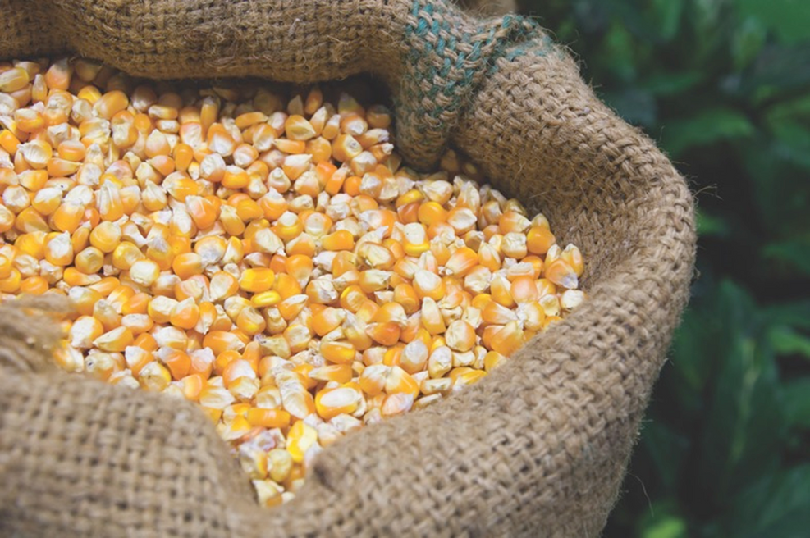
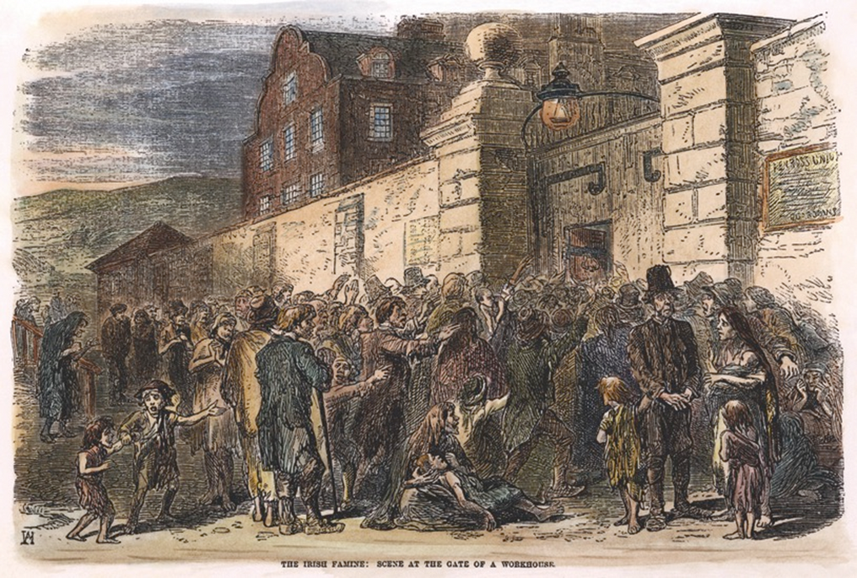
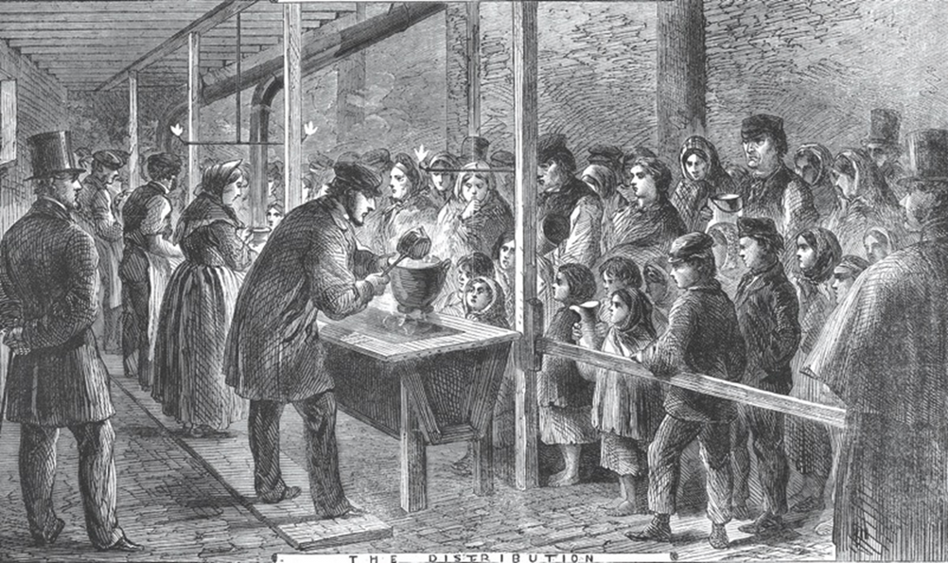
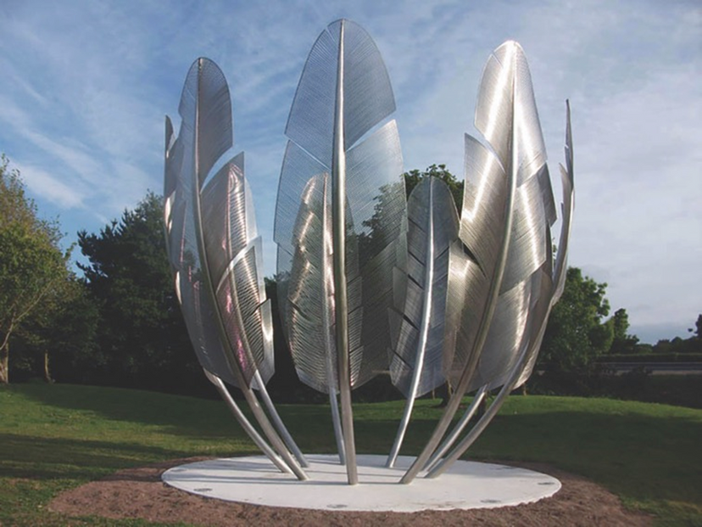
Strand Two: The History of Ireland
Chapter Seventeen: The Great Famine
Diagram taken from Artefact, 2nd Edition by Eimear Jenkinson and Gregg O'Neill (educate.ie)
@MsDoorley

Slide 21
Famine Relief Efforts
Most aid came from voluntary or charity organisation in the forms of soup kitchens and donations.
  In late 1846, the Religious Society of Friends (the Quakers) set up soup kitchens in towns such as Waterford, Enniscorthy, Limerick, Clonmel and Youghal. Soup kitchens gave hot soup to starving people who were not in workhouses. In mid-1847, the government set up its own soup kitchens.
  Money was raised by the Quakers to give practical and financial help to the Irish – for example clothing and funding for fishers. For example, clothing was gathered from Britain for the winter of 1846-1847 and fishermen got funding to recover the equipment they had sold to feed their families.
  Groups such as the Quakers raised awareness world wife of Ireland's need, and donations came from at least 19 different countries.
    Queen Victoria (1819-1901) was the reigning monarch of Britain during the Irish Famine. Although she was sympathetic to the suffering of the Irish people, her powers were limited by the constitutional monarchy system. Victoria supported private﻿ charitable efforts to provide relief to the Irish, but was criticized for not doing more to pressure the government to take action. She did send about €172,000 in today’s money from her personal account.
    Abdülmecid I (1823-1861) was the Sultan of the Ottoman Empire during the Famine. In 1847, he offered to donate £10,000 to aid the Irish people, but the British g﻿overnment declined the offer as they believed that it would make Queen Victoria look bad for donating less than the Sultan. The gesture was nevertheless widely reported in the press and has since been celebrated as a symbol of intercultural empathy and generosity.
    Pope Pius IX sent money from his private income (€19,000).
    Even the Choctaw Nation (at the time only displaced from its homeland and had suffered a high loss of life) raised money for those starving in Ireland.
Strand Two: The History of Ireland
Chapter Seventeen: The Great Famine
@MsDoorley

Slide 22
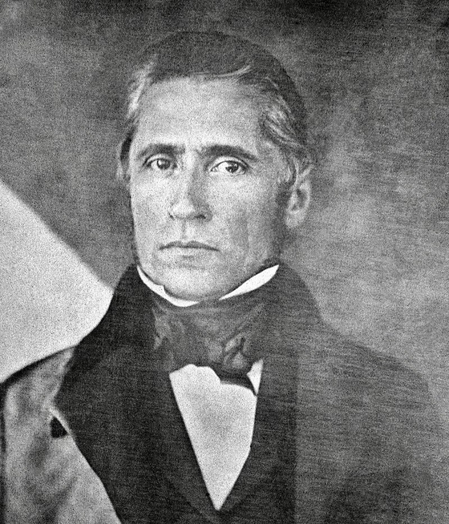
Sir Paul Edmund Strzelecki, 1796-1873
Sir Paul (Pawel) Edmund Strzelecki was born near Poznan, in modern-day Poland. He was an explorer, geologist and philanthropist who arrived in Ireland in 1847 as an agent of the British Relief Association at a time when millions were dying of starvation and disease. He devised an innovative system of feeding and clothing children through schools across the most famine-stricken western part of Ireland. At its peak, the scheme fed and clothed over 200,000 children of all religious backgrounds every day. Strzelecki also helped impoverished Irish families to seek new lives in Australia. Despite suffering the effects of typhoid fever, which he contracted in Ireland, Strzelecki continued to dedicate himself tirelessly to hunger relief throughout the Great Famine.
Strand Two: The History of Ireland
Chapter Seventeen: The Great Famine
@MsDoorley

Slide 23
Checkpoint pg. 176 (Artefact, 2nd Edition)
  Why was the British government so slow to act in response to the blight in Ireland?
  Explain the term laissez-faire as it relates to government policy at the time.
  How did the government try to help with (a) maize and (b) public works schemes?
  What was a workhouse? What were the advantages and disadvantages of entering a workhouse?
  What were soup kitchens?
  Name some people and groups that donated money for famine relief.
Strand Two: The Nature of History
Chapter Seventeen: The Great Famine
@MsDoorley

Slide 24
1845 to 1851
Chapter 17
17.3: THE IMPACT OF THE FAMINE ON IRELAND
17.3: the impact of the famine on ireland
Strand Two: The History of Ireland
@MsDoorley

Slide 25
The Impact of Famine on Ireland
The famine devasted Ireland’s population through starvation, disease and emigration but also had much more wide-ranging consequences. These consequences greatly affected Irish society, some changes which still exist today.
Fall in population: the 1841 census showed there were over 8 million people on the island of Ireland. The population dropped by over 2 million between 1845 and 1850. It would continue to drop for another century due to emigration. And Ireland’s population would never regain its pre-Famine levels.
Change in farming practices: though the crop failed because of the potato plight, the Famine only took hold and lasted because Irish farmers were so vulnerable. End of sub-division of land. Eldest son was now given the land and others went to towns in search of work or were forced to emigrate. Many landlords changed their land from tillage (crop) farming to pastoral (cattle) farming after the Famine.
Marriage age rose due to lack of means (land used to be given with a bride as a dowry) which coincided with a decline in birth rates as it meant less children.
Rise in Anti-British feeling: Many blamed the British for the people’s suffering during the Famine. Anger at the exportation of Irish crops led to a rise in support for nationalist groups and a desire for Home Rule. This would help lead to the uprisings and rebellions that would happen in the late 19th and early 20th Century.
Decline of the Irish language: The west and south-west of Ireland were worst hit by the Famine. Over time, people began to favour English over Irish as it would help them find work elsewhere if they needed to emigrate.
New emigration trends: In the 1881 census, the Irish population had fallen by three million (or 37%) since 1841. The US and Britain were the main destinations for the Irish. There they found steady work and were able to pay for their families to join them.
Strand Two: The History of Ireland
Chapter Seventeen: The Great Famine
@MsDoorley

Slide 26
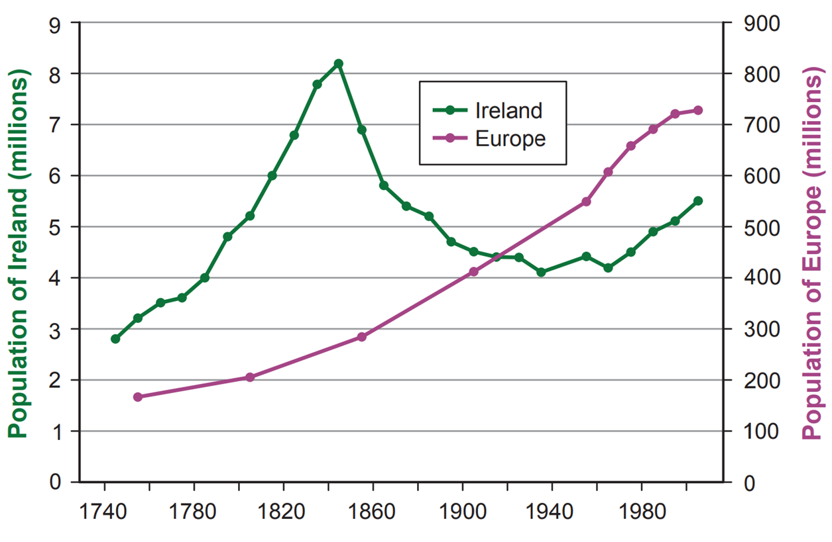
Strand Two: The History of Ireland
Chapter Seventeen: The Great Famine
Diagram taken from Artefact, 2nd Edition by Eimear Jenkinson and Gregg O'Neill (educate.ie)
@MsDoorley

Slide 27
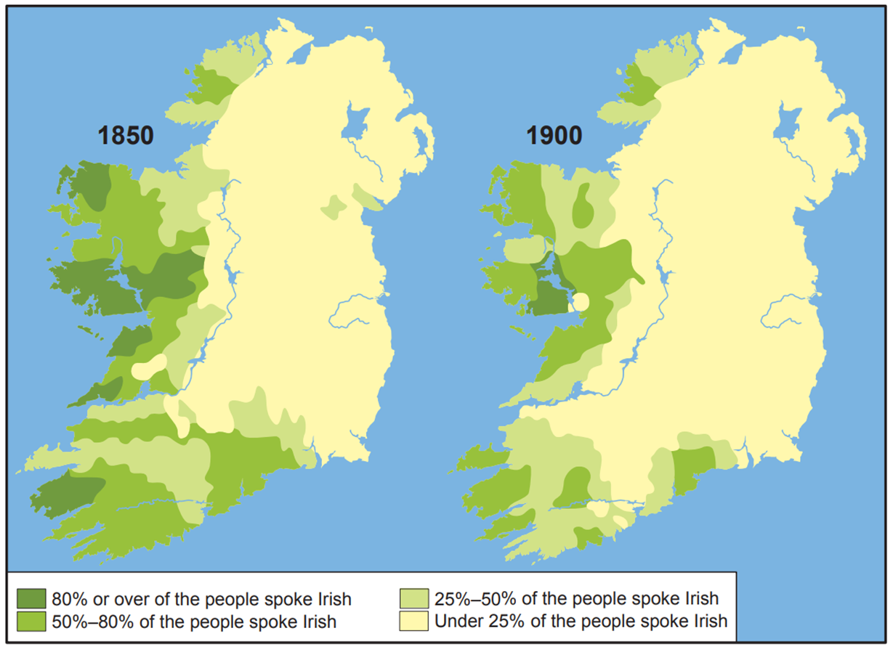
Strand Two: The History of Ireland
Chapter Seventeen: The Great Famine
Diagram taken from Artefact, 2nd Edition by Eimear Jenkinson and Gregg O'Neill (educate.ie)
@MsDoorley

Slide 28
Checkpoint pg. 181(Artefact, 2nd Edition)
  How many people either died or emigrated between 1845 and 1850?
  How did changes to farming practices contribute to continued emigration?
  How did the British government’s actions during the Famine affect political beliefs among Irish people?
  Which areas of the island were hardest hit by the Famine?
Strand Two: The Nature of History
Chapter Seventeen: The Great Famine
@MsDoorley

Slide 29
City of Chicago – Christy Moore
In the City of Chicago
As the evening shadows fall
There are people dreaming
Of the hills of Donegal
1847 was the year it all began
Deadly pains of hunger drove a million from the land
They journeyed not for glory
Their motive wasn't greed
A voyage of survival across the stormy sea
To the City of Chicago
As the evening shadows fall
There are people dreaming
Of the hills of Donegal
Some of them knew fortune
Some of them knew fame
More of them knew hardship
And died upon the plain
They spread throughout the nation
They rode the railroad cars
Brought their songs ant music to ease their lonely hearts
To the City of Chicago
As the evening shadows fall
There are people dreaming
Of the hills of Donegal
Strand Two: The History of Ireland
Chapter Seventeen: The Great Famine
@MsDoorley

Slide 30
Working with Sources
  What year is mentioned in the song, and what significant event began in that year?
  What was the main reason people left Ireland according to the song?
  Where did the Irish immigrants in the song primarily settle?
  How did the Irish immigrants contribute to American society, as per the song?
  What kinds of experiences did the Irish immigrants have in America, according to the song?
  What does the song imply about the lasting impact of the Irish Diaspora?
Strand Two: The Nature of History
Chapter Fourteen: The 1798 Rebellion
@MsDoorley

Slide 31
Working with Sources (Answers)
  The year mentioned is 1847, often referred to as "Black '47," one of the worst years of the Great Famine in Ireland.
  According to the song, the main reason people left Ireland was the "deadly pains of hunger," indicating that they were fleeing the Great Famine. Their motive was survival, not glory or greed.
  The song specifically talks about the City of Chicago as a place where Irish immigrants settled.
  The song mentions that Irish immigrants brought "their songs and music to ease their lonely hearts," implying that they contributed to the cultural landscape of America.
  The song states that "Some of them knew fortune, some of them knew fame, more of them knew hardship and died upon the plain." This indicates a variety of experiences, including both success and hardship. It also makes referenced to those who died upon the Coffin Ships before they reached American shores.
  The song implies that the memory of Ireland remains strong among the descendants of Irish immigrants in places like Chicago. As the evening shadows fall, "there are people dreaming of the hills of Donegal," indicating a lasting connection to their homeland.
Strand Two: The Nature of History
Chapter Fourteen: The 1798 Rebellion
@MsDoorley

Slide 32
1845 to 1851
Chapter 17
17.4: THE IRISH DIASPORA
17.4: the irish diaspora
Strand Two: The History of Ireland
@MsDoorley

Slide 33
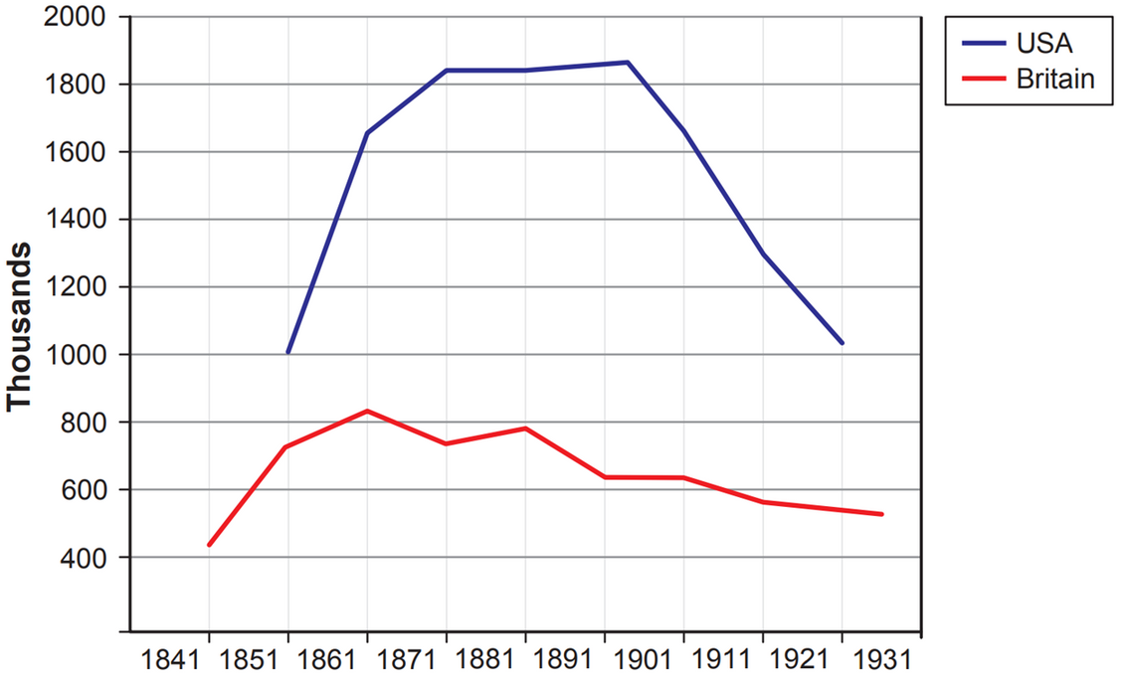
Ireland and Emigration
Emigration continued after the Famine as Irish migrants settled in and brought their families with them (chain migration). Sons and daughters who would no longer inherit land went abroad to seek work too. These destinations included Britain, USA, Canada, Australia, South Africa, New Zealand and more. These emigrants became the Irish Diaspora; the scattering of Irish migrants and their descendants across the world.
Forced mass migration from Ireland is dated back to the Flight of the Earls in 1607 during the Ulster Plantation, but from the 1840s onwards, it soared. Not until the 1970s did inward migration briefly overtake migration.
Strand Two: The History of Ireland
Chapter Seventeen: The Great Famine
Diagram taken from Artefact, 2nd Edition by Eimear Jenkinson and Gregg O'Neill (educate.ie)
@MsDoorley

Slide 34
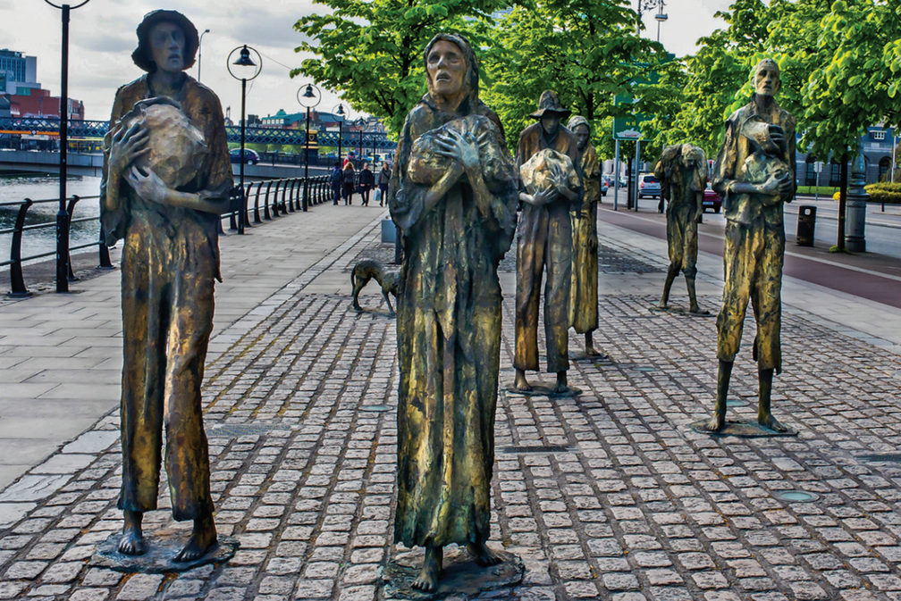
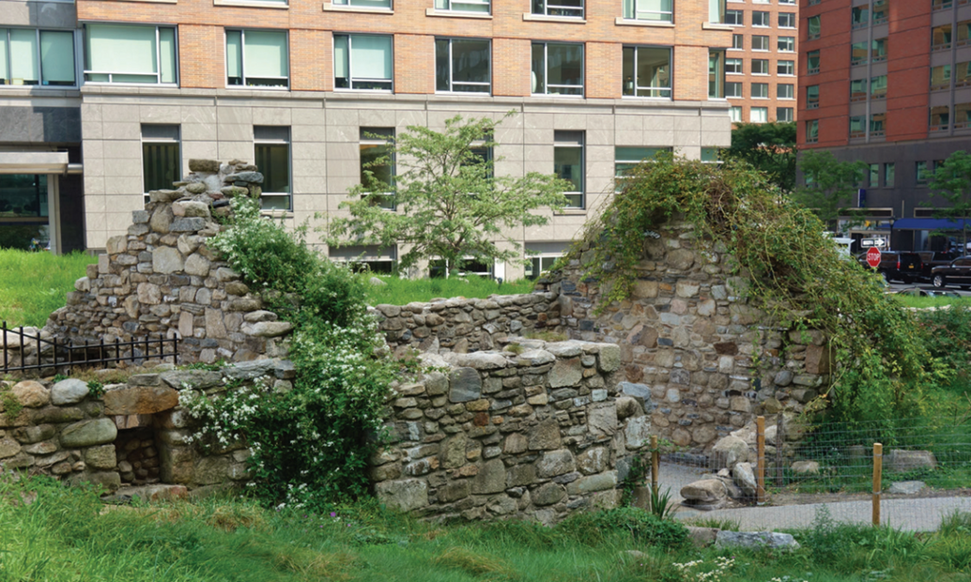
Strand Two: The History of Ireland
Chapter Seventeen: The Great Famine
Diagram taken from Artefact, 2nd Edition by Eimear Jenkinson and Gregg O'Neill (educate.ie)
@MsDoorley

Slide 35
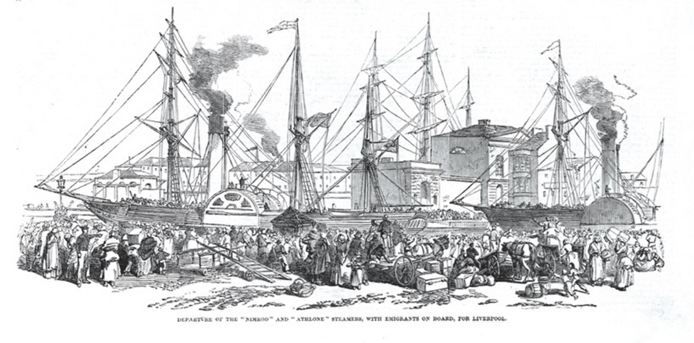
The Irish diaspora in Britain
While Ireland was in the throes of famine, Britain had experienced the first industrial revolution. As covered in the previous chapter, many inventions led to the improvements in manufacturing of items and producing food.
Irish emigration to British cities (Manchester, Liverpool and Glasgow) was not new. For example, shortly before the Great Famine, 17.3% of the population of Liverpool was Irish. It was cheap to travel to Britain. People sailed on crowded steamships that were built to transport animals and grain. Many travelled on the open deck, which was cold and dangerous. Diseases like typhus travelled with the migrants. For some, Britain was the first stage of their journey to America.
Strand Two: The History of Ireland
Chapter Seventeen: The Great Famine
Diagram taken from Artefact, 2nd Edition by Eimear Jenkinson and Gregg O'Neill (educate.ie)
@MsDoorley

Slide 36

Life in Britain for the Irish diaspora
  The Irish were amongst the poorest, living in the slums of Industrial Britain. Many Irish survived on handouts and begging. When they could get work, they accepted lower wages than the British, making them unpopular with their counterparts.
  Many died of diseases such as typhus because of the unsanitary and overcrowded living conditions in the slums.
  When conditions began to improve, the Irish became part of the industrial working class as publicans or shopkeepers.
  The Irish were heavily involved in building trade and transport, particularly as dockers.
  They were also involved in the building of the British canal, road and rail networks in the 1800s.
  Gradually, the Irish married into the British population and moved up the social class system
  Migration continued throughout the 1900s. Today, up to six million people in the UK have an Irish-born grandparent (around 10% of the population)
Strand Two: The History of Ireland
Chapter Seventeen: The Great Famine
Did you know?
Article 18 of the FIFA constitution states that 'any person who is a naturalised citizen of a country by virtue of that country's laws shall be eligible to play for a national or representative team of that country'. This rule is particularly beneficial for the Republic of Ireland soccer team. Irish citizenship laws state that no matter where a person is born, anyone whose parent or grandparent is an Irish citizen is entitled to Irish citizenship. This has become nicknamed 'the Granny Rule' in Irish soccer and has gained such players as Shay Brennan, Ray Houghton, Mick McCarthy, Jason McAteer and Kevin Kilbane for the team.
@MsDoorley

Slide 37
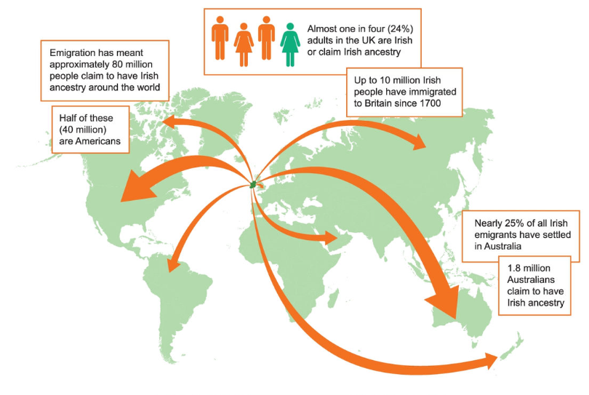
Strand Two: The History of Ireland
Chapter Seventeen: The Great Famine
Diagram taken from Artefact, 2nd Edition by Eimear Jenkinson and Gregg O'Neill (educate.ie)
@MsDoorley

Slide 38
Checkpoint pg. 174 (Artefact, 2nd Edition)
  Explain the term Irish diaspora..
  Why did many Irish Famine emigrants choose to go to Britain?
  What kinds of jobs did the Irish in Britain have?
  How did Irish emigrants impact on Britain and British people?
  How many people around the world claim Irish ancestry?
  What proportion of Irish emigrants settled in Australia?
Strand Two: The Nature of History
Chapter Seventeen: The Great Famine
@MsDoorley

Slide 39
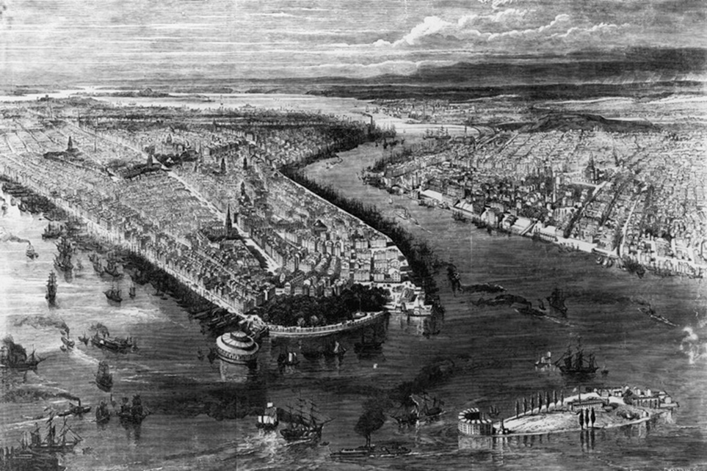
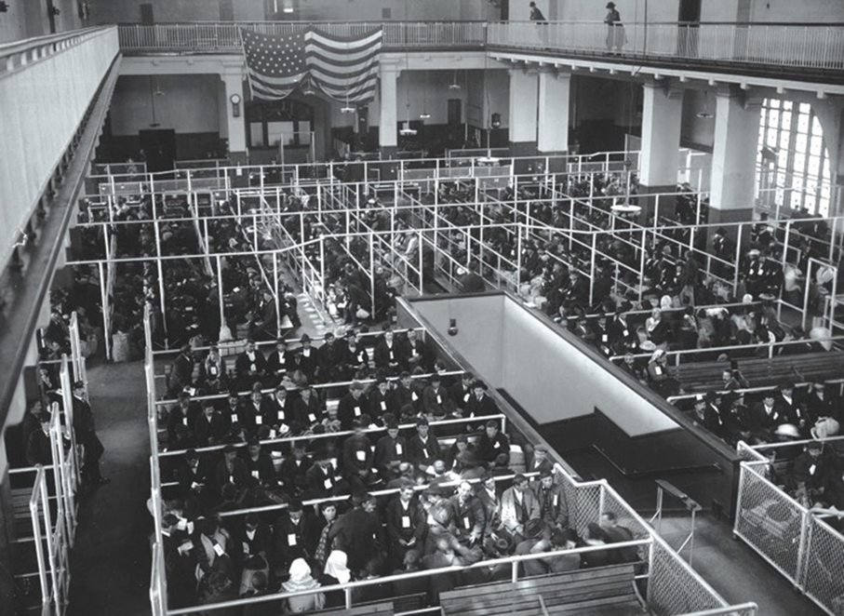
The Irish diaspora in the USA
Emigration to the United States was expensive. The journey was long and difficult – and if you made it there, the immigration rules were strict. The main entry for the Irish was through New York City (although some took the cheaper option to Canada and then later crossed the border on foot). Until 1890, the main immigration point was at Castle Garden (Manhattan). All immigrants then went through a temporary Barge Office until the famous Eilis Island centre opened in 1892.
Strand Two: The History of Ireland
Chapter Seventeen: The Great Famine
Diagram taken from Artefact, 2nd Edition by Eimear Jenkinson and Gregg O'Neill (educate.ie)
@MsDoorley

Slide 40
Life in the USA for the Irish diaspora
  Between 1841 and 1850 around 910,000 Irish emigrated to the US – 250,000 in 1847 alone.
  The Famine migrants were Catholics who spoke Irish – not welcomed by the largely Protestant American population.
  Most Irish were uneducated and made up the low wage manual labour. In the 1860s during the American Civil War they were recruited to serve in the US Army against the Confederates. After the war, they made up most of the workforce who built the Union Pacific Railroad. It is believed that 200,000 Irishmen fough in the American Civil War.
  The Irish suffered discrimination when the economy was slow. For example, in the 1850s “No Irish Need Apply” and “No Blacks. No Dogs. No Irish” were familiar signs.
  Many Irish-Americans had a deep hatred towards the British government and went on to support Irish nationalist movements (The Fenians and the Irish Republican Brotherhood).
  Today, over 41 million Americans claim Irish ancestry including:
    John F. Kennedy, Ronald Reagan, Barack Obama and Joe Biden (22 Presidents)
    Walt Disney, Chris Evans (Captain America), Alfred Hitchcock, Nick Jonas
    Quentin Tarantino, F. Scott Fitzgerald, Muhammad Ali, Jennifer Aniston
    Anne Hathaway, Billie Eilish, Macaulay Culkin, Harrinson Ford, Robert Downey Jr.
    And many, many more…
Strand Two: The History of Ireland
Chapter Seventeen: The Great Famine
@MsDoorley

Slide 41
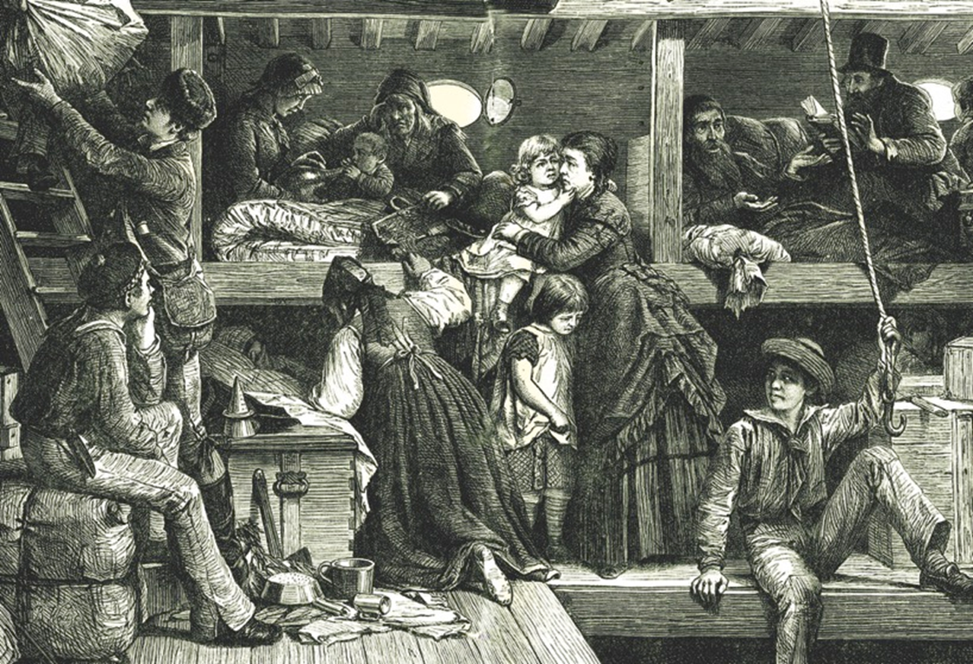
Strand Two: The History of Ireland
Chapter Seventeen: The Great Famine
Diagram taken from Artefact, 2nd Edition by Eimear Jenkinson and Gregg O'Neill (educate.ie)
@MsDoorley

Slide 42
Checkpoint pg. 174 (Artefact, 2nd Edition)
  What problems were faced by the Irish who emigrated to America?
  What kids of work did they do?
  What impact have Irish immigrants had on America and on the American people?
Strand Two: The Nature of History
Chapter Seventeen: The Great Famine
@MsDoorley

Slide 43
1845 to 1851
Chapter 17
17.5: SUMMARY
17.5: summary
Strand Two: The History of Ireland
@MsDoorley

Slide 44
In this chapter, we have learned that...
  The causes of the Great Famine (1845-1850) include: a rise in population; poverty; subdivision of land; reliance on the potato; work in exchange for rent rather than cash; potato blight
  The British government was slow to act when the potato blight hit. Some help came eventually in the form of maize, public work schemes and workhouses. However, most help came from voluntary and charity organisations in the form of soup kitchens and donations.
  The consequences of the Great Famine include: a steep drop in population; emigration; the decline of the Irish language; the end of subdivision; changes to agriculture; anti-British feeling.
  People emigrated to countries such as Britain, Australia, Canada and the US during and after the Great Famine, creating the Irish diaspora.
Strand Two: The History of Ireland
Chapter Seventeen: The Great Famine
@MsDoorley

Slide 45
Reflecting on... The Great Famine
Until the twentieth century, the Great Famine was the worst catastrophe in modern European history. Its impact is still felt today: Ireland continues to tend towards emigration, particularly in times of economic hardship. Perhaps due to our own experience, we have a strong tradition of donating to and working in developing countries. Though Ireland is still strongly agricultural, the Famine was a turning point: thereafter, the Irish diversified their crops and sought livelihoods outside farming. Our population has never returned to pre-Famine levels, although millions around the world claim Irish roots.
Strand Two: The History of Ireland
Chapter Seventeen: The Great Famine
@MsDoorley

Slide 46
SEC Examination Questions
2021 SEC Sample Q5
2022 SEC Q5
2023 SEC Q3
Strand Two: The History of Ireland
Chapter Seventeen: The Great Famine
@MsDoorley

Slide 47
Project
Guidelines:
  Length: The depth of your project should reflect about 2-3 weeks of work.
  Sources: Use at least three different sources for your research. These can be books, scholarly articles, or reputable online resources.
  Citations: All information and images that are not your own should be properly cited.
  Mediums: You may choose to present your project in one of the following ways:
    Poster: Your poster should be informative and visually engaging.
    Minecraft or Lego Model: If choosing this option, please also include a brief report explaining your model.
    Painting/Drawing: Your artwork should be accompanied by a description.
    Recycled Materials: Create your model using recycled materials and provide an explanation of your creative process.
Assessment:
Your projects will be assessed based on:
  Research and Content
  Creativity and Presentation
  Understanding of Context
  Adherence to Guidelines
Strand Two: The History of Ireland
Chapter Seventeen: The Great Irish Famine
@MsDoorley

Slide 48
Project
Historical Sites
Historical Figures
Famine Memorial, Dublin, Republic of Ireland
Skibbereen Heritage Centre, County Cork
Grosse Île, Quebec, Canada
Murrisk Abbey, County Mayo
Kilrush Famine Commemoration, County Clare
Sir Robert Peel
Dr Dan Donovan (Skibbereen)
Jonathan Pim
Archbishop MacHale, Tuam
Rev. Robert Traill
Patrick Kennedy (Wexford)
Lord John Russell
Archbishop Murray, Dublin
Charles Trevelyan
Joseph Bewley
Queen Victoria
Asenath Nicholson
Strand Two: The History of Ireland
Chapter Seventeen: The Great Irish Famine
@MsDoorley

